Slide 1

Pan.da’s Panini
Little sandwich shop willing to adopt new technologies

Slide 2



The problems
Writing down the orders received via whatsapp.
Orders are possible only until 11.30
Usually clients forget details in the order and the owner spends time replying to them.

Slide 3




The solutions
Automatic printing of the orders.
No-stop orders.
Telegram bot which handles the ordering process.

Slide 4

Abstract
" Do you usually waste time asking the clients for the orders? Do they always forget
something? Pandaspaninibot is here for you! A simple and quick way to manage
orders and make your clients taste a delicious sandwich. "

Slide 5
Project idea
The project idea consists in creating a Telegram bot which allows Marco, the shop owner, to automatically manage the online orders, without the need to write down on paper every message and without stopping the service after a certain hour.
The bot interacts with a MKR1000 Arduino board, which is connected to a little thermical printer able to print out an order every time it is confirmed on Telegram.
The printer is placed inside a laser cutted wooden box. It is unique and customized with the Pan.da’s logo, becoming a real decor object. On the box it is also mounted a LED, which will blink when a new order is received.

Slide 6
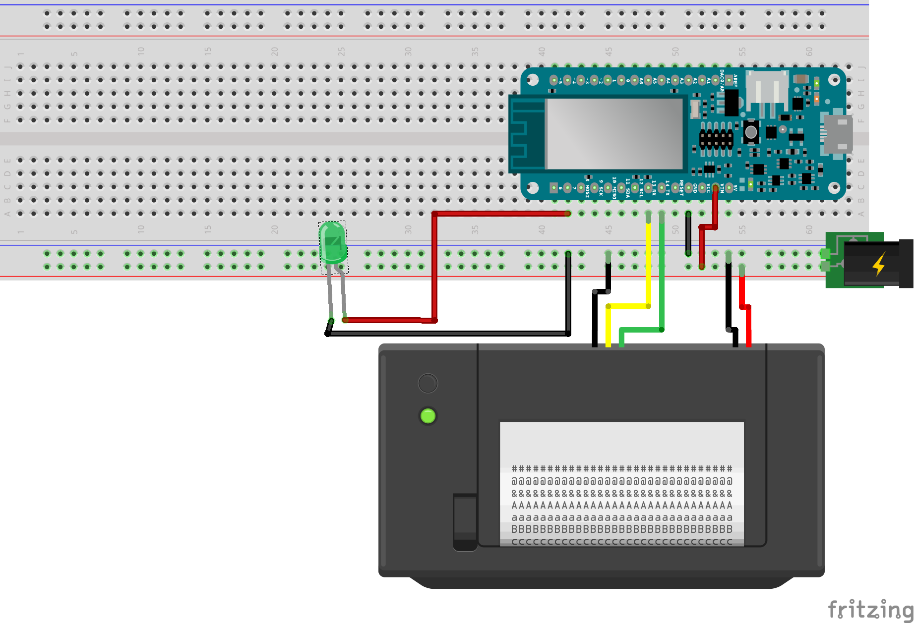
Materials
Mini Thermal Receipt Printer
MKR1000 Arduino board
5 volt power supply
Different connectors
Breadbaord
1x LED
Original laser cutted case

Slide 7
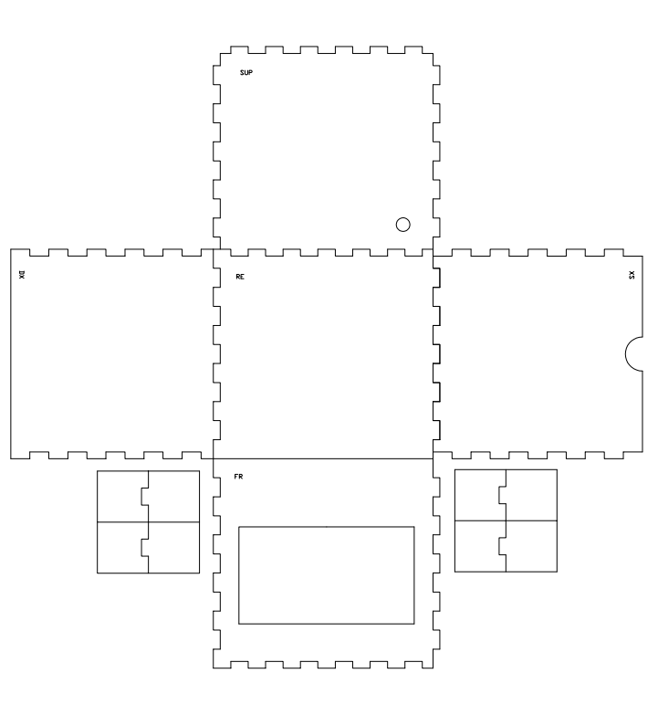
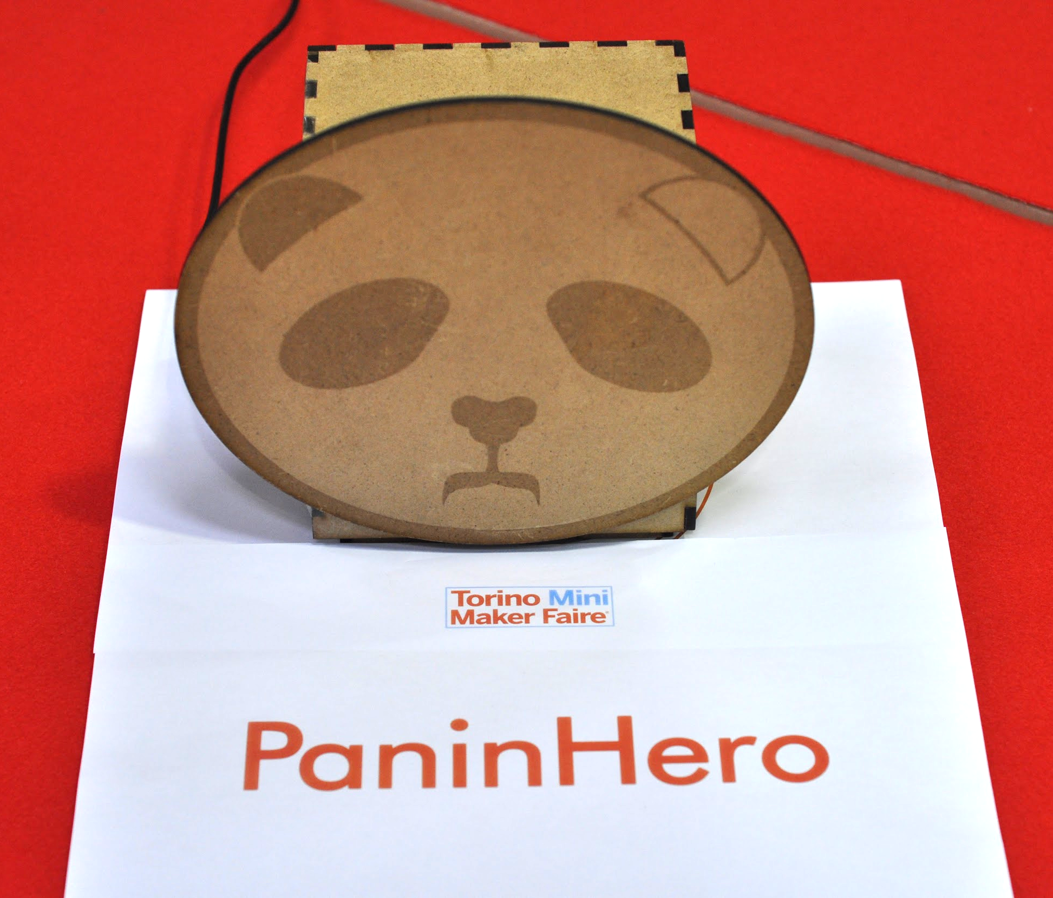
The case
We created the case laser cutting a 4mm plywood.

Slide 8

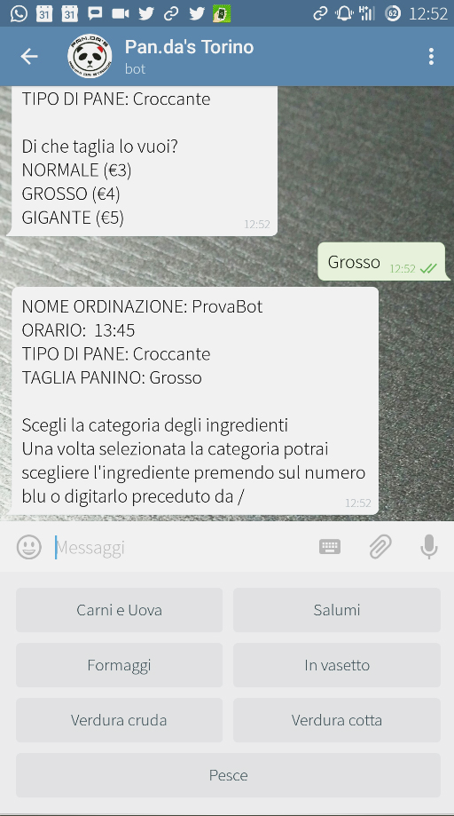
Minimum Viable Product
Our MVP is a Telegram bot, able to manage a sandwich order and print it out by a thermal printer with a formatted output.
The printer is placed inside a 4mm plywood case, with the Pan.da’s logo engraved on the front side.
A notification green led is mounted on the top.

Slide 9
About Pan.da’s
65 INGREDIENTS EVERY DAY
GREATER AFFLUENCE MOMENT
to choose from to create your customized sandwich, 10 special Pan.da’s sauces to combine and only in the shop: 5 more extra ingredients of the week.
the “hottest” moment is between 12:30 and 14:30, in fact, after 11:30 they can’t afford to receive any new orders through Whatsapp.
AVERAGE CLIENTS
2 SHOPS
IT students, professionals, hospital workers.
C.so Svizzera 149/C - Torino
C.so Inghilterra 43 - Torino

Slide 10






The current order
“Hey Panda! I’d like a 4€, crunchy and hot sandwich.
Ingredients: 15, 27 and 13.
Sauces: 2 and 3. For 12:30.
Choose the size
Choose the ingredients
Choose the sauces
ORDER
You can order in two different ways:
Going directly to the shop and filling the sandwich form you can find on the desk.
Using Whatsapp chat, sending a message with your choices, name and booking time.

Slide 11
The new order
OPEN THE BOT
ORDER PRINTED
Choose the size
Choose the ingredients
Choose the sauces
Order
EASIER, FASTER, BETTER!

Slide 12
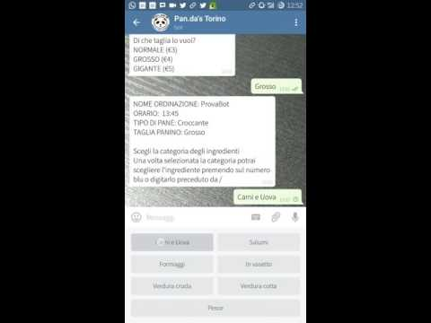
Pan.da’s Bot in action!

Slide 13
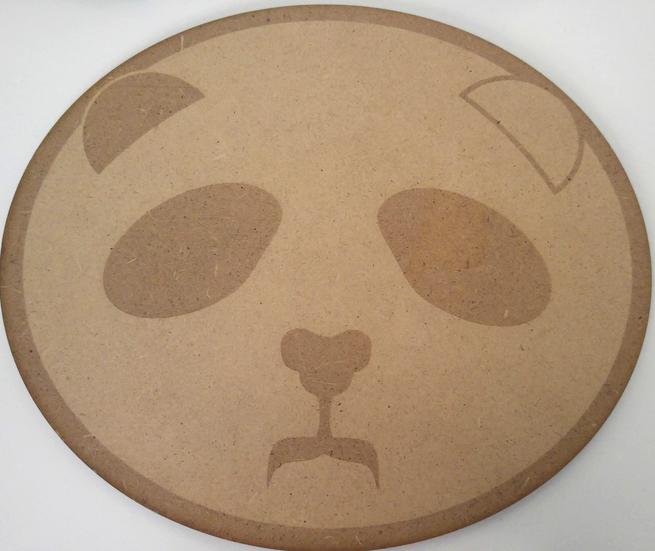
THANK YOU!

